Slide 1
Annual Report 101
Seneca District
Reporting Year 2019

Slide 2
Home Page: https://pa.countingopinions.com

Slide 3
A username and password are required. Same as last year
If unable to log in, try another browser. If still unable, try another PC. System does get busy or “go down”. Wait and try again.
Call Leslie to see if she can get into the system.
Answer ALL questions that pertain to your library and fill out all tables (Utilize last year’s report).
Report cannot be submitted if there are items unanswered. (Edit checks.)
Round to the nearest full dollar. No cents.
Software totals for you (shaded boxes)! Your printed copy will NOT show the shaded boxes—don’t “TOTAL”, wait and let the software do it for you so you aren’t double adding things. Numbers on the far right are last year’s numbers, so you can track if you are on par.
Use notes to explain data. Also a helpful tool to remind you of extraordinary circumstances that may have occurred during the year.
Leslie can view the report and make changes. Please call if you are working on it and have specific questions.
Do not “panic” if your numbers don’t match! Call Leslie.

Slide 4
Print blank form: https://pa.countingopinions.com/
Note statistics required.
Gather statistics from calendar year 2019. If your library doesn’t collect a required stat, start collecting that data ASAP. (i.e. Wireless Internet usage—if you don’t have the router capability to count—you should be doing a quarterly sampling.)
Follow instructions for indicating statistics not collected.
OCL emailed directors with instructions, due dates and CHANGES for 2019. (Friday, January 17, 2020)

Slide 5
Know Your Library
Double check all the data about your library
Fill in the current director’s information
No one is part of a system in the Seneca District and no one has a bookmobile. Do not answer questions regarding these items.
Know your legislators
What type of Library are you?
What are your hours open? Lines 43-48

Slide 6
Population figures: pre-populated by Commonwealth Libraries. Won’t change until after the next census.
Annual Public Service Hours: CALCULATE! Subtract out days your library was closed!! Holidays, weekends, emergencies, renovation, community event days. Subtract from your Annual Public Service Hours! Make notations for anything extraordinary that happened to decrease those hours.
Use the “note” feature (to the left of the answer ) )to explain edit checks and anything unusual or extraordinary that occurred.

Slide 7
What is a reference question?
Definition: A reference transaction includes information and referral service as well as unscheduled individual instruction and assistance in using information sources (including web sites and computer-assisted instruction). Count Readers Advisory questions as reference transactions.
Information sources include (a) printed and non-printed material; (b) machine-readable databases (including computer-assisted instruction); (c) the library's own catalogs and other holdings records; (d) other libraries and institutions through communication or referral; and (e) persons both inside and outside the library.
When a staff member uses information gained from previous use of information sources to answer a question, the transaction is reported as a reference transaction even if the source is not consulted again.
If a contact includes both reference and directional services, it should be reported as one reference transaction. Duration should not be an element in determining whether a transaction is a reference transaction.
NOTE: It is essential that libraries do not include directional transactions in the report of reference transactions. Directional transactions include giving instruction for locating staff, library users, or physical features within the library. Examples of directional transactions include, “Where is the reference librarian? Where is Susan Smith? Where is the rest room? Where are the 600s? Can you help me make a photocopy?”

Slide 8
Annual number of library visits: your library should “really” have a mechanism in place for calculating: quarterly tally (multiplied by 6.5); electronic people counters.
The state wants it to be close to accurate.
www.sensourceinc.com affordable solutions, door counters.

Slide 9
Where do you find this information?
ILS (Polaris or Evolve)
Financial Information
Line 42 will come from ILS
Lines 51 & 52 will come from ILS
Statistical Summary under the System reports-Polaris
Summary of Checkout/or physical Items-Evolve
Cheat Sheet on 52a & 52c
Refer to Chart of Account Provided With Line Items

Slide 10
Print off a year-end financial statement for 2019. Bookkeeper, board treasurer, director; whomever keeps the books.
Quick Books will do this. If you do not use QB, then you must CREATE ONE for submission.
Is it organized according to the line-items of the annual report?
It should be easy to read: income, expenditures, beginning balance, ending balance, transfers in.
Should NOT be a treasure hunt. Everything should be separated out into categories.
Not a statement of accounts.
PLEASE type library name and year on the financial statement! Commonwealth Libraries is reviewing 500+ reports.

Slide 11
Who should complete the financial portion of the report?
The library director should “really” complete the entire report. If you have other departments that can work on stats, a business manager that can clarify figures, an assistant director…
If your board’s treasurer keeps all of the books and maintains a neat financial statement, they can and should assist, but the director is the one who signs off on the accuracy of the report.
The library director should be involved in the annual budget process, managing of the budget and be in know of the library’s incomes/expenditures (daily, monthly, yearly).
If I have a question or the Office of Commonwealth Libraries has a question, we will be contacting the library’s director.

Slide 12
Work Programs
Did your library have a Title 5 (AARP or Senior) employee during 2019?
Request documentation from the agency, ASAP. Documentation must be on agency letterhead; must be signed; must be broken out wages/SS/Medicare.
Without matching documentation the income/expenditures will be disallowed.
If the agency doesn’t cooperate, you can use the employee’s W-2.

Slide 13
Shared Expenses
Does your library share a facility? (Borough/Municipality building)
Does the municipality pay for the library’s portion of some (or all) utilities? Not in-kind.
Print off the Shared Expenses Form and take it to the municipality for completion. Both columns must be completed. Form must be signed. Form must have the municipal seal.
Only the portion paid by the municipality on behalf of the library can be counted.

Slide 14
Local Government Income
Local support from your borough, municipalities and school district.
Add a line for each municipality (including the school district.)
Even if you get ZERO $$, add each municipality.
For reporting purposes, County Aid counts as Local Government Income, but is listed in a separate section.
Does your municipality pay other expenses for your library out-right? Those count here as well. Get documentation on municipality letterhead containing exact figures. Building Insurance, Utilities… NOT “in-kind”—must be something paid out-right by the municipality.
Documentation from the municipality must be signed (an original signature—not a fax).

Slide 15
Complete a “sloppy copy” first. Mark it up with explanations and categories. You will need to refer back to it next year.
Make sure income and expenditures on the annual report “balance” with your year-end financial statement. If it doesn’t contact Leslie.
Don’t forget transfers-in and transfers-out.
Don’t forget beginning balance (last year’s ending balance).
Don’t forget any grant money that may be carried over from year-to-year.
Complete form online: underlined numbers are hyper-links to instructions/directions for that number.
Any questions? Call Leslie.
Get your financial statement to me as soon as you have finished the report so it can be balanced AND reviewed.

Slide 16
Original, Paper Copy documentation must be submitted to the district. Do NOT send directly to the state.
Deadline for paper documentation, March 1.
I must verify everything is there and figures match what is recorded in the annual report.
Cover Sheet (Checklist)
Signature Page: Board President & Treasurer must sign.
Shared Expenses: Certification of Estimated Costs. Municipal form with signature and seal.
Employment verification letters
Treasurer’s report: original/clean copy (indicating library & year).
Librarian or Boards Annual Report.

Slide 17
Deadlines:
Annual Reports: must be completed online by March 6.
In order to be reviewed, your 2019 year-end, financial statement is required. Send a digital copy of the financial statement ahead, so I can begin to review.
I do not need a paper copy of your report.
All paper documentation should be turned in by March 6.
Reports can’t be submitted without it.
Audits/Reviews:
Audits/Reviews due to the district center by September 1. No exceptions.
Late audits/reviews jeopardize state aid and grant opportunities for your library.

Slide 18
SUMMARY OF ACCOUNTS
Beginning Balance + Transfers In + Revenue - Total Expenditures - Transfers Out = Ending Balance Please enter the total expenditure for each row. If no expenditure, enter 0.
MUST BE COMPLETED!
This section MUST balance.

Slide 19
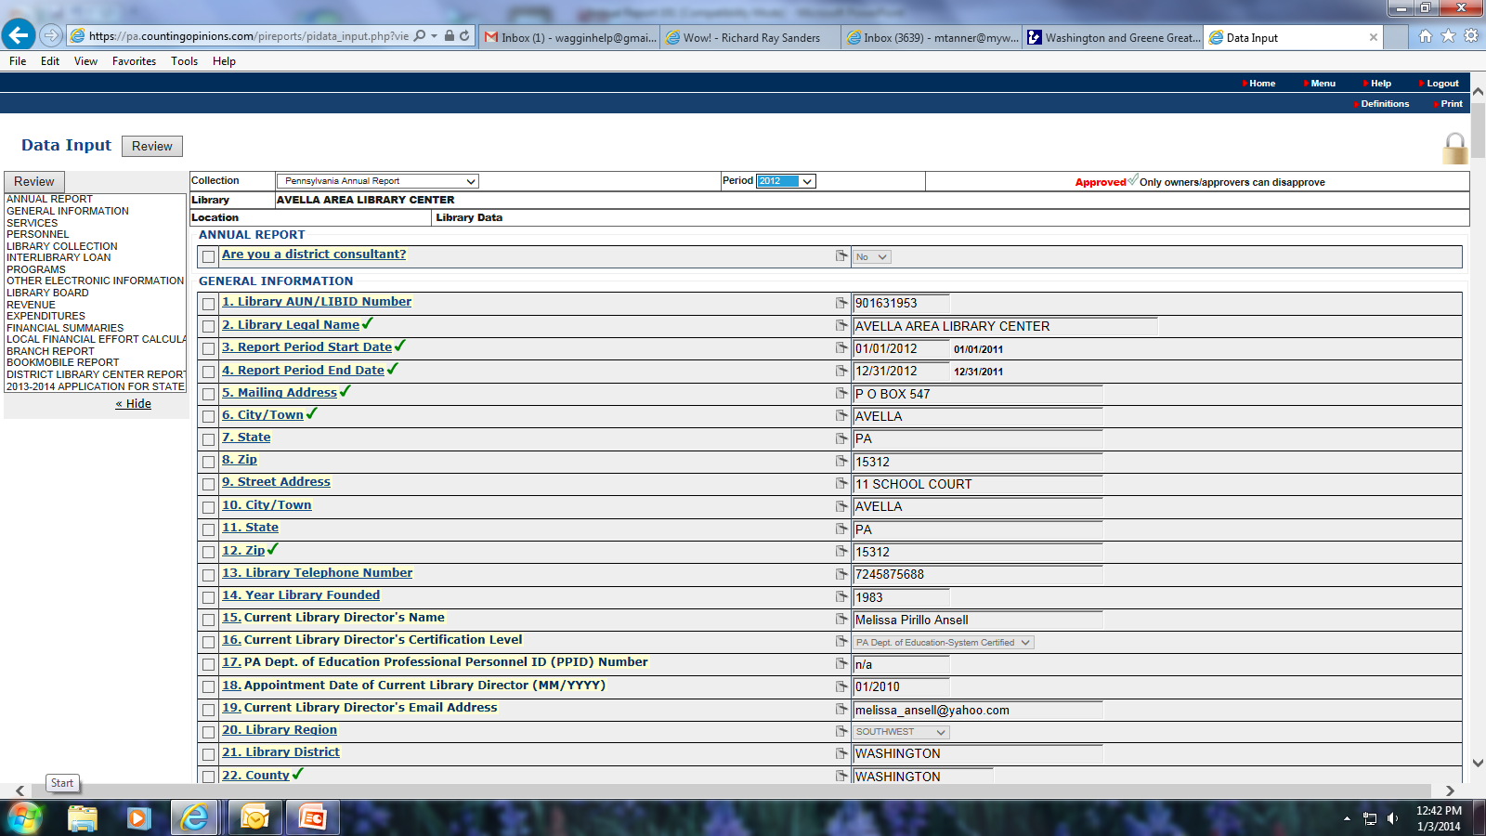
Save from the Print Command.

Slide 20
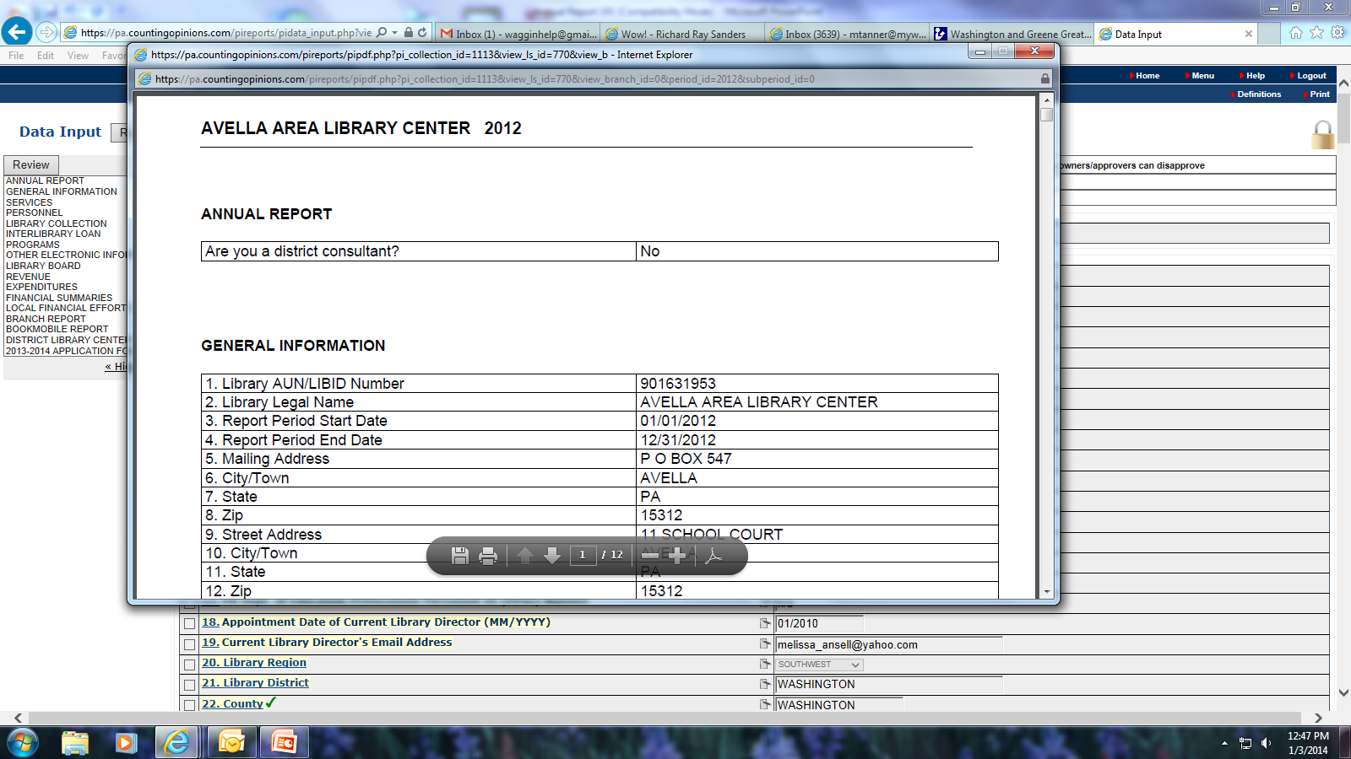
Download PDF. Save Command on PDF.

Slide 21
Do not wait for the library’s yearly audit/financial review to complete annual report.
Please let Leslie know if you are having issues and will be running late completing the report.
Schedule your library’s audit/review for June, July or August. It is due to Leslie by September 1.
Send an original audit/review to Leslie for submission to Commonwealth Libraries. The district does not need a copy. Leslie will copy the cover letter. The cover letter must have consistent wording: audit throughout or review throughout.

Slide 22
Common Issues:
Blank questions.
Salary & benefits information left blank (grid).
Number of hours worked weekly left blank.
Misc. Revenue and Misc. Expenditures should not be over $1,000.
Sales tax does not count as income or expenditures: in/out. Collecting it to pay to the state.
E-Rate is not income. Rebates or insurance claims are not income. Subtract from appropriate expenditure line item.
Explain any gifts classified as other.
List gift, giver and value. Gifts are things bought brand new specifically for the library. Not second-hand, not donations.
County Aid and State Aid confused. County Aid is part of local government income.
Local Effort page (last page) often left blank. Please complete.

Slide 23
Software not perfect.
If you notice that something didn’t carry over, for instance beginning balances, please let me know so I can notify (OCL). They will need to input the information.
Pre-filled data: if you notice an error or need to edit, please let me know so I can notify OCL.

Slide 24
For 2020
Programming Stats
For 2020 Tracking for next year’s report, I highly recommend using the following form so we can easily compile in the correct groups and track.
QuickBooks
Utilize the provided chart of account with the corresponding annual report line item numbers
ILL
Run all ILL through AccessPA to accurately track stats. If you need help setting up your borrowing list, please ask!
Catalog
If your collections are not correct or your reports are not setup to run the ones necessary for the annual report, please ask for help!

Slide 25
TIMS and PPID #’s
Leslie can email you the updated instructions.
PPID numbers are mandatory if you have public library certification. If you do not have a PPID number, insert 7 – zeros.
You must do this step yourself, asks for specific information.

Slide 26
???Questions???

